Slide 1
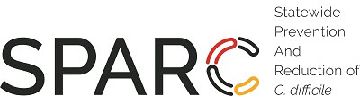

Reflex urine culturing:
“Dos and Don’ts”
Surbhi Leekha MBBS, MPH
Associate Professor
University of Maryland School of Medicine

Slide 2
Take-home points
Reflex urine culturing is a key diagnostic stewardship strategy for UTI among hospitalized patients
1
The starting point for a reflex urine culture is suspicion of UTI, not a urinalysis
2
Misuse of reflex urine culturing can paradoxically increase incidence of positive urine cultures
3

Slide 3
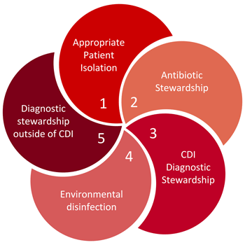
Relevance of UTI diagnosis to SPARC
Diagnostic stewardship is the process of improving ordering, processing, and reporting of infection diagnostic tests → improve antimicrobial use
Distinct SPARC domain(s)
UTI common cause of unnecessary antibiotic use and focus of diagnostic stewardship
https://maryland-sparc.org/index.html

Slide 4
Why should we focus on the diagnostic aspect?
Original Goal: Avoid treatment of asymptomatic bacteriuria
Efforts to increase
  Awareness of asymptomatic bacteriuria (ASB)
  Knowledge of lack of benefit from ASB treatment
However
  Positive urine culture STRONG stimulus to treat, regardless of symptoms
  Revised Goal: Avoid ordering & reporting of unnecessary urine cultures
  a.k.a. Diagnostic stewardship for UTI

Slide 5
Why is UTI over-testing common among hospitalized patients?
Culturing for inappropriate symptoms
  Change in urine character
Non-specific appropriate symptoms: fever, leukocytosis
  ‘Pan’-culturing for fever or sepsis
50% of patients with NHSN-CAUTI and 30% with clinical CAUTI diagnosis have alternate cause of fever
True urinary symptom-based urine culturing is difficult to achieve in hospitalized patients
Leekha ICHE 2015

Slide 6

What about other elements of UTI diagnosis?
  1. Symptoms
  2. Positive urine culture (bacteriuria)
  3. Pyuria (urine WBC)
→ Non-specific in hospital setting
→ Common in hospital, catheter, elderly
1 + 2 = Bad Combination

Slide 7
Pyuria and UTI
Urine WBCs or pus cells or pyuria: Inflammation in the urinary tract
Presence of pyuria has low positive predictive value
  Positive UA or pyuria ≠ UTI
However, absence of pyuria has high negative predictive value
Absence of pyuria in a patient with non-specific symptoms (e.g., fever) suggests an alternative cause for fever
Basis of reflex urine culturing
Juthani-Mehta M, ICHE 2007
Tambyah PA Arch Intern Med 2000
Stovall RT, J Am Coll Surg 2013

Slide 8
Reflex Urine Culturing: Protocol
Perform urine cultures only when urinalysis / microscopy criteria met
  Replaces a routine or “regular” urine culture order
Most commonly used criteria: Pyuria (UA WBC > 10 per hpf)
  Threshold of “10” supported by literature and lab Cumitech guide
  Leukocyte esterase in UA ≈ WBCs on microscopic exam
Other criteria: nitrite, bacteria
  Different from pyuria – presence of bacteria
  Not all bacteria reduce nitrate to nitrite
  Does not say anything about inflammation
Humphries J Clin Micro 2016
Cumitech ASM Press 2014

Slide 9
Workflow
(University of Maryland Medical Center)
When order is placed, 2 labels print for urine collection: yellow top tube (UA) and grey top tube (urine culture)
Both tubes sent to lab accessioning with appropriate volumes
Lab Accessioning sends yellow top tube to Chemistry and grey top tube to Microbiology
Urinalysis performed in the Chemistry lab
WBC result of > 10per hpf generates order for urine culture visible to the Microbiology lab, and a urine culture is performed
If no urine culture order generated for Microbiology, the specimen for urine culture is discarded

Slide 10
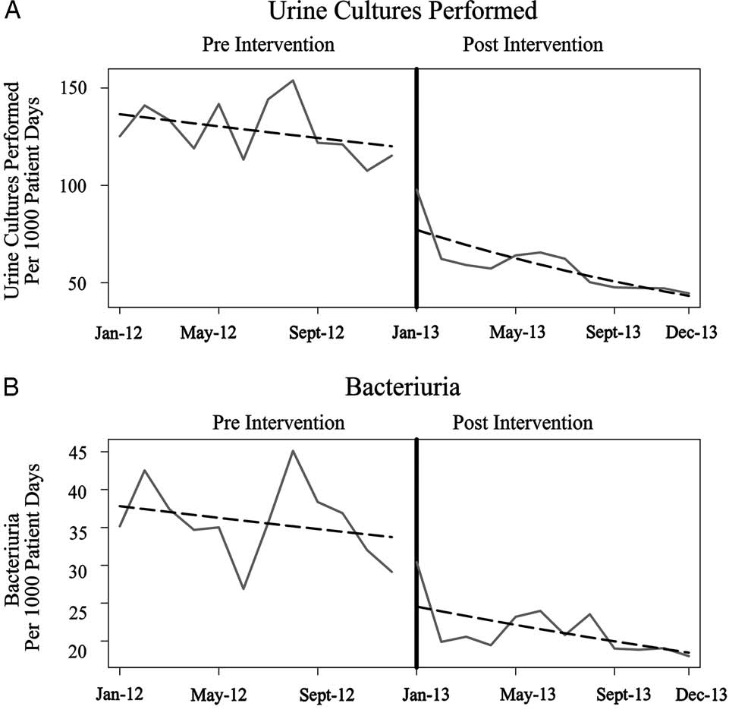
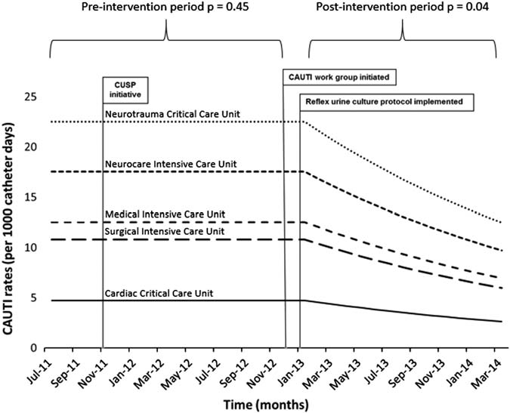
Impact: Significant decreases in urine cultures performed, bacteriuria, and CAUTI
Epstein ICHE 2016
Sarg ICHE2016

Slide 11
Impact: Antimicrobial Use
Among randomly selected 250 ICU patients pre- and post-intervention who had urine culture ordered
Fewer patients with positive urine cultures
  post vs. pre (40 vs. 77, P <.001)
Fewer patients started new antimicrobial therapy for UTI
  post vs. pre (23% vs 41%, P= .002)
No change in overall ICU antimicrobial days of therapy
  ↑2 DOT for every urine culture ordered: intimate link between culturing and antibiotic use
Sarg ICHE 2016

Slide 12
Stakeholders
Antimicrobial Stewardship (reduce unnecessary UTI treatment)
Infection Prevention (reduce reported CAUTI)
Lab/Microbiology (reduce volume of cultures to work-up)
Hospital Leadership ($$$)
Clinicians
  Providers
  Urology
  Nurses
IT: Orders analyst, lab IT

Slide 13
Reflex Urine Culturing “Dos”
(1) Map hospital process for ordering, collection, processing of urinalysis and urine cultures
Review all order-sets with urine culture orders
  Remove where unnecessary!
Wherever possible, make “reflex urine culture” the default urine culture order
Consider exceptions: pregnancy, urology, renal transplant, neutropenic
  Unable to exhibit pyuria
  Positive urine culture significant regardless of pyuria

Slide 14
Reflex Urine Culturing “Dos”
(2) Automate process at level of the lab
When urinalysis criteria met, “order” for urine culture generated for Microbiology lab
  Work with Lab IT
Avoid manual “checking” of UA result and urine culture order placement: delays

Slide 15
Reflex Urine Culturing “Dos”
(3) Ensure specimen collection and transport for urinalysis and urine culture occurs simultaneously
Kits are helpful
Avoids later urine culture collection when results may be affected by antibiotic use or specimens sitting at bedside

Slide 16
Reflex Urine Culturing “Dos”
(4) Use reflex urine culturing as part of overall diagnostic stewardship strategy
Ordering in presence of symptoms
Best practices for reporting
  Not reporting individual organisms in mixed flora

Slide 17
Reflex Urine Culturing “Dos”
(5) Supplement with additional IT interventions to facilitate appropriate ordering
Order panels with appropriate indications
  Can be customized for different patient populations (e.g., patients with and without indwelling urinary catheter)
Best practice alerts e.g., guide to urine reflex when regular urine culture selected
Reports with feedback of urine culture orders

Slide 18
Reflex Urine Culturing “Don’ts”
(1) Do not make the urinalysis the starting point for UTI diagnosis
Always start with symptoms
Common fallacy: Screening UA regardless of symptoms, ED “triage”
Paradoxical increase in “UTI” rates
Reason: expanded pool of asymptomatic people tested, non-specific pyuria and bacteriuria detected

Slide 19
Reflex Urine Culturing “Don’ts”
(2) Do not eliminate routine urinalysis
Urinalysis has many other uses beyond infection diagnosis
  Evaluation of kidney injury
  Diabetes
  Electrolyte abnormalities
If no routine urinalysis option, then positive UA in asymptomatic patients/patients with UA sent for non-infectious reasons will reflex to culture → ASB not UTI
  (recall that positive UA or pyuria ≠UTI)

Slide 20
Current state: urine culturing practices survey among SHEA Research Network members
Of 52 hospitals, 26 (50%) performed reflex urine cultures
  24 (92%) also allowed urine culture without reflex
  Criteria for “positive” urinalysis varied
    96% using different WBC thresholds
    76% also using positive leukocyte esterase or nitrite
Perceived impact on UTI rates
    27% saw decrease
    27% perceived no change
    11% observed an increase
Only 4 required documentation of indication while ordering urine cultures
Implementing in ED or outpatient
Sullivan ICHE 2019

Slide 21
Take-home points
Reflex urine culturing is a key diagnostic stewardship strategy for UTI among hospitalized patients
1
The starting point for a reflex urine culture is suspicion of UTI, not a urinalysis
2
Misuse of reflex urine culturing can paradoxically increase unnecessary urine cultures
3

